Slide 1
Resolution in Predicate logic
Cenan Horea Calin-912

Slide 2
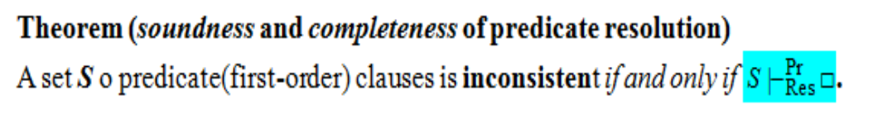
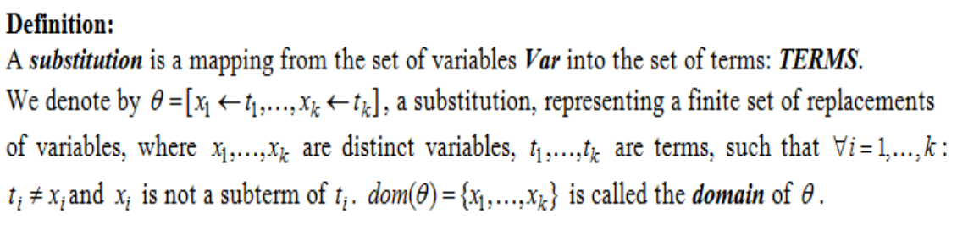
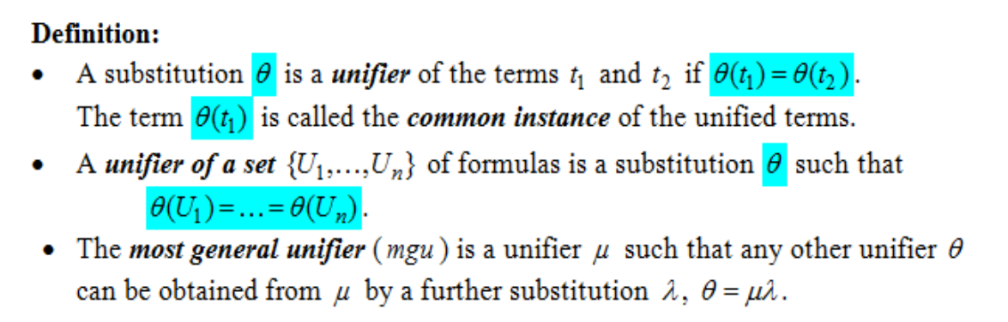
Theoretical results
Inconsistency – A formula U is inconsistent if it has no models (all interpretations are anti-models if and only if all interpretations evaluate the formula as false)
Clause – A disjunction of a finite number of literals

Slide 3
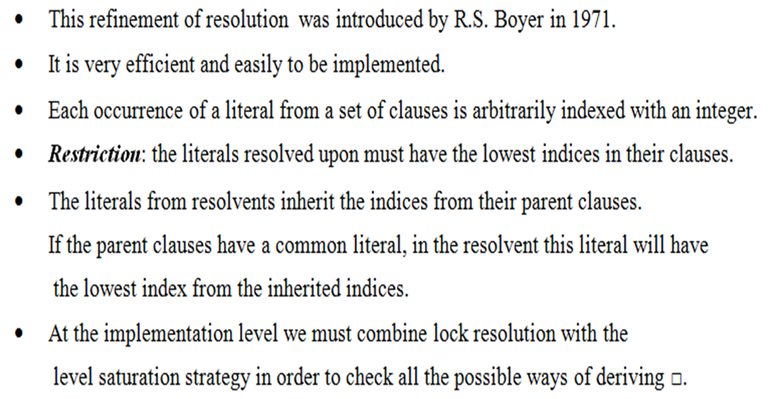
Lock resolution

Slide 4


First type of indexing literals
Clauses:
The following resolvents are obtained:
C1= (2) P(x) ∨ (1)¬Q(x)
C2 = (3)¬P(a) ∨ (4)R(x)
C3 = (5) Q(x)
C4 = (6) W(z)
C5 = (8)¬R(y) ∨ (7) ¬W(y)
C6=Res^{Pr} (C1,C3)= (2) P(x)
C7=Res_{θ1=[z←y]}^{Pr}(C4,C5)= (8) ¬R(y)
_{Θ1=mgu(z,y)}
C8=Res_{θ2=[x←a]}^{Pr}(C2,C6)=(4)R(a)
_{Θ2=mgu(x,a)}
C9=Res_{θ3=[y←a]}^{Pr}(C7,C8)= □
_{Θ3=mgu(y,a)}
Conclusion:

Slide 5
Second type of indexing literals:
Clauses:
The following resolvents are obtained:
C1= (1) P(x) ∨ (2)¬Q(x)
C2 = (3)¬P(a) ∨ (4)R(x)
C3 = (5) Q(x)
C4 = (6) W(z)
C5 = (8)¬R(y) ∨ (7) ¬W(y)
C6=Res_{θ1=[x←a]}^{Pr} (C1,C2)= (2)¬Q(a) ∨ (4)R(a)
C7=Res_{θ2=[z←y]}^{Pr}(C4,C5)= (8) ¬R(y)
C8=Res_{θ3=[y←a]}(C3,C6)=(4)R(a)
C9=Res_{θ4=[y←a]}^{Pr}(C7,C8)= □
Conclusion:

